Slide 1
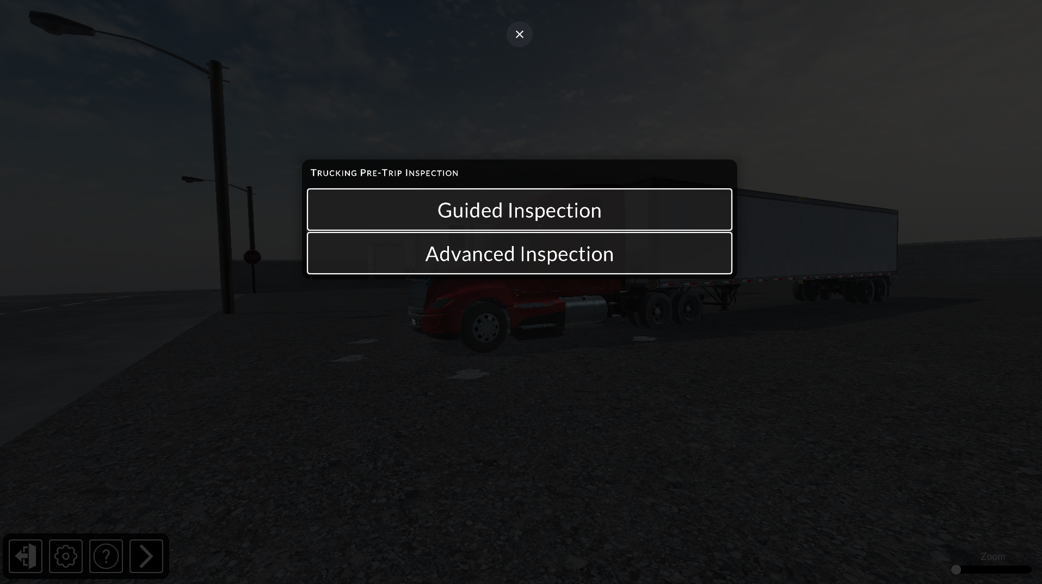
Pre-Trip Inspection Menu

Slide 2
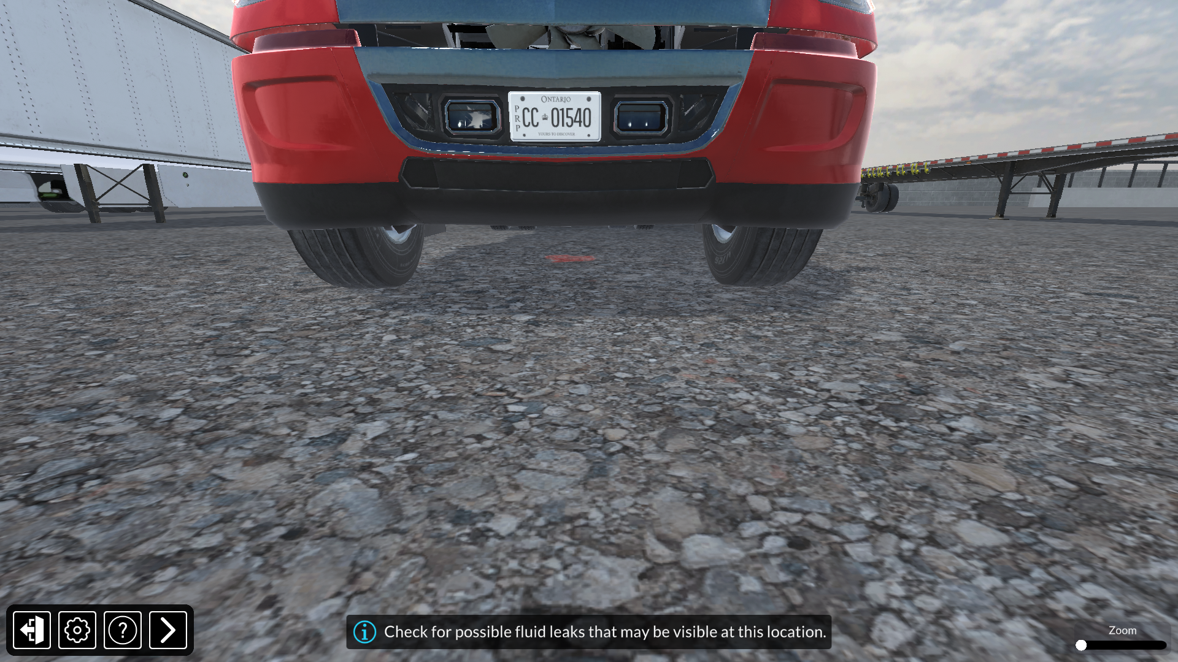
Settings
Tutorial
Zoom Adjustment
Exit
Next Inspection
Hint

Slide 3
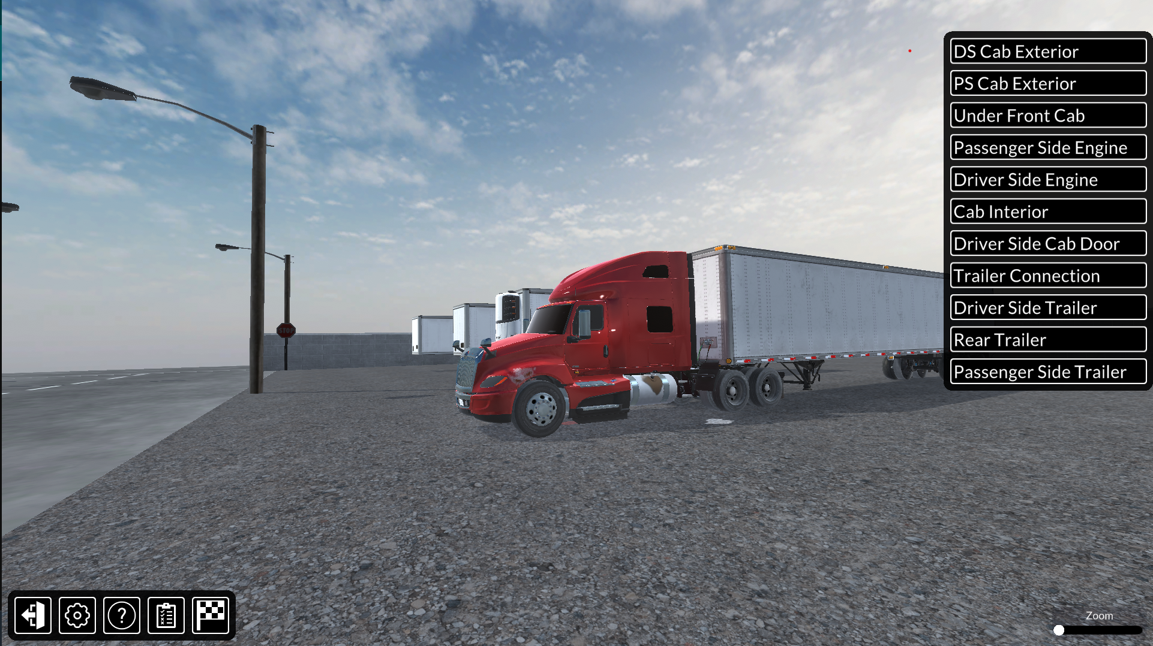
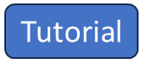
Side Menu
Settings
Zoom Adjustment
Exit
Checklist
Finish

